Slide 1
Guide for optimisation of time procedure of Transrectal biopsy on Trinity

Slide 2
Table of content
Introduction
Importing MRI
Contour Page – MRI/US
Panorama
Transrectal Biopsy
Additional details

Slide 3
Introduction
We've pinpointed steps in the Trinity Transrectal protocol where modifications can speed up the process. This guide is created by the expertise of Trinity's users.
We’ve also observed that the procedure's speed often correlates with the patient's comfort level. Utilizing resources like calming ambient music, conversing with the patient, and explaining the process can effectively reduce stress and anxiety.
Keep in mind that the recommendations provided here are based on observations. It's essential to tailor them to fit your specific practice.

Slide 4
Importing MRI
To streamline the process and minimize delays during import:
Importing from CD: ensure that only the necessary MRIs, at least the T2 are burned onto the CD. When possible, including a DICOMDIR* on a CD allows for quicker importation of images.
When possible, import the images a day before. The PACS remains the best solution for importing and managing the MRIs
Importing from USB: ensure that only the necessary MRIs are saved onto the device.
*A DICOMDIR is an index file in the DICOM standard that organizes and provides access to medical images and related data stored on removable media like CDs or DVDs.

Slide 5
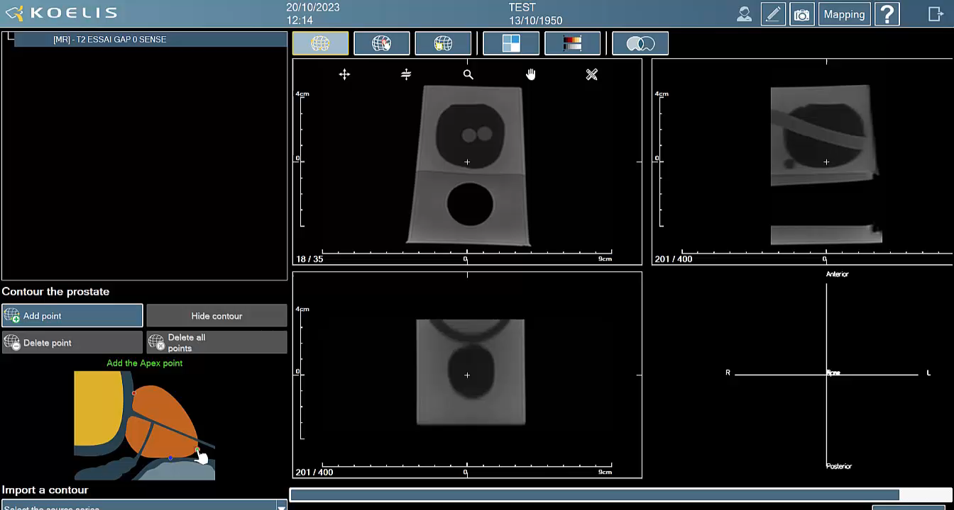

Contour Page – MRI/US
After importing the MRI and positioning the primary three points, you do not need to use the Inter-slicer tool to navigate through the MRI slices.
Simply click and hold the left mouse button on the Sagittal view and drag left or right. This action will cause the Axial view to automatically scroll through the slices as well.
You can also use the scroll buttons (down/up) on the mouse to simply navigate among the slices.
Click on the video to see how it works
The import and contour of the MRI can be done before the biopsy exam to save time on the intervention day.
You can also use the scroll buttons (down/up) on the mouse to simply navigate among the slices.

Slide 6
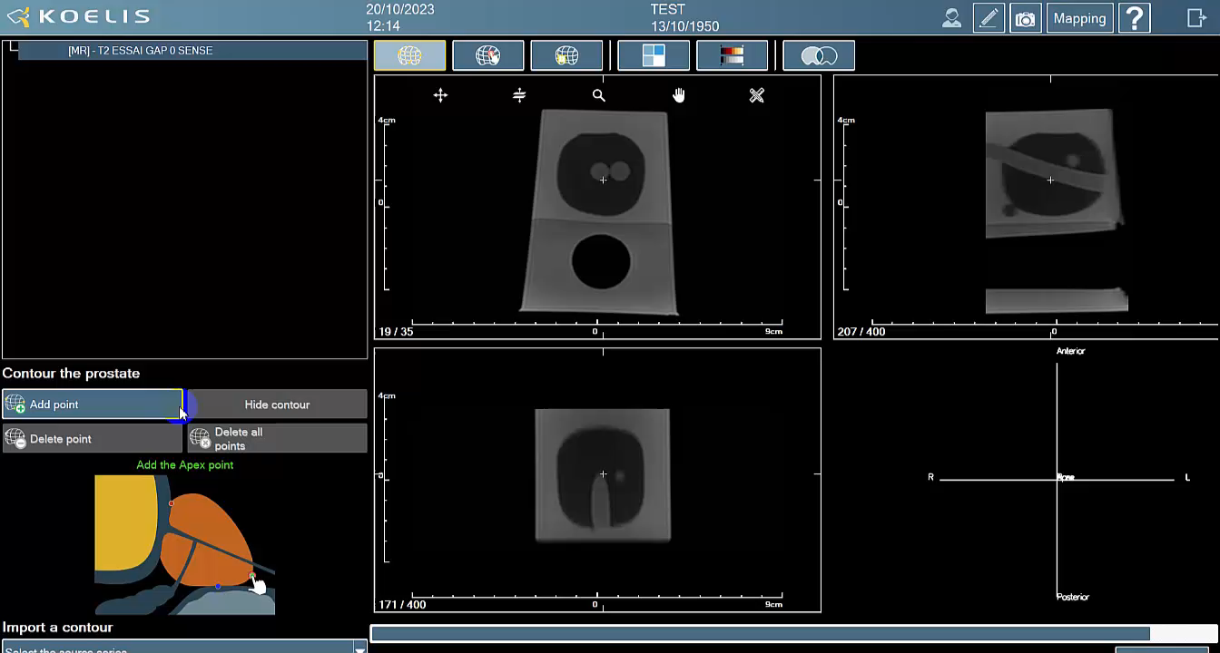
Contour Page – MRI/US
You can click over a misplaced yellow point and reposition it by dragging it, rather than deleting.
Click on the video to see how it works

Slide 7
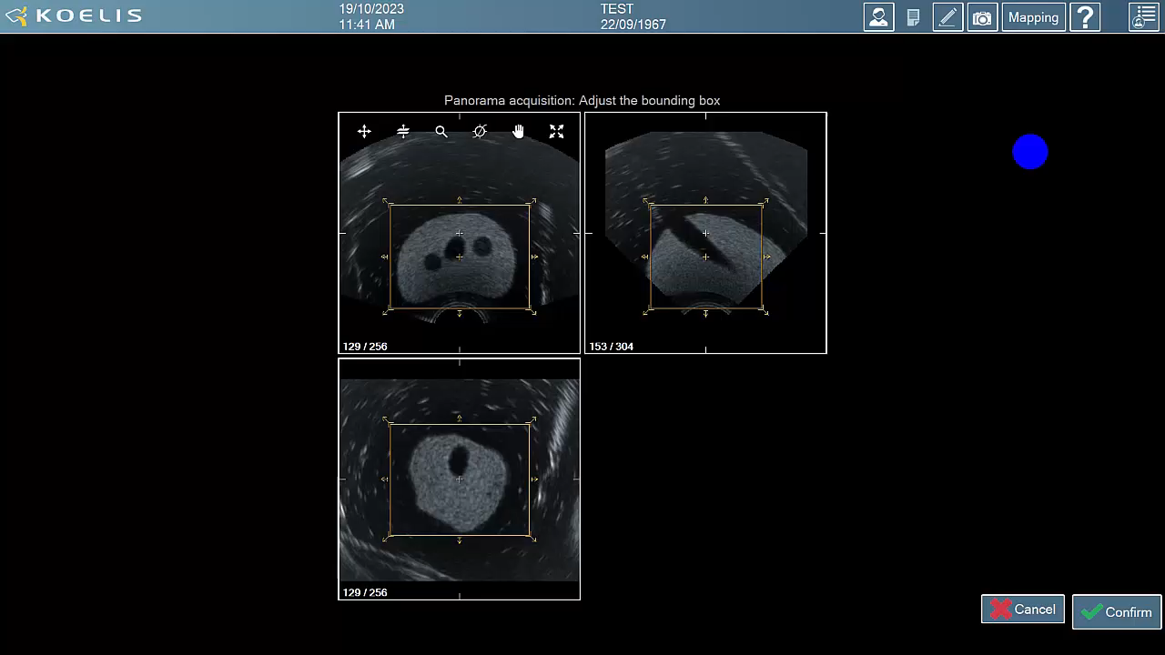
Panorama
In the bounding box setting, you can quickly adjust it by clicking on the arrows at the corners of the box.
Click on the video to see how it works

Slide 8
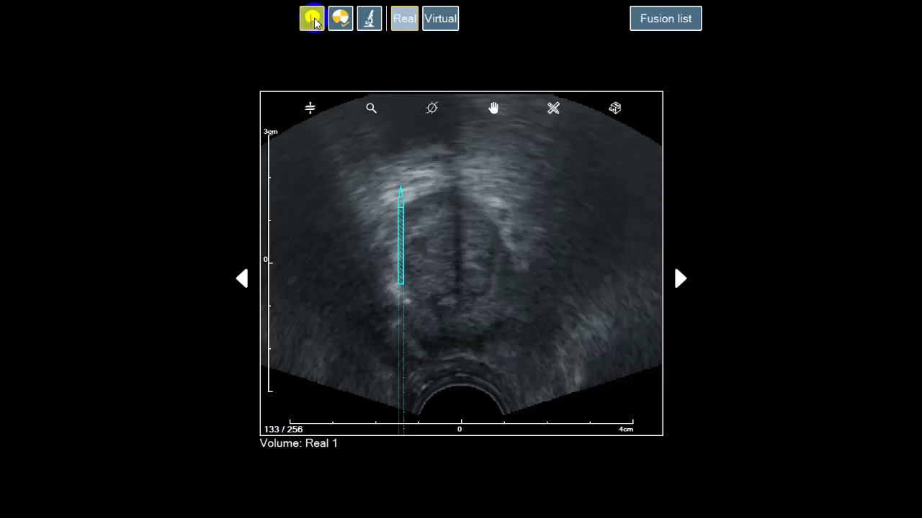
Biopsy
When firing the needle, you can press the pedal for Real 3D acquisition at the same time. As soon as the needle is seen on the 3D scanning, the needle can be removed from the prostate.
You can do the alignment of the blue needle to the track of the needle once the exam is finished Only for systematic/random biopsies under Transrectal approach
Navigate to the 'Fusion' list and select the desired needle for alignment. By making this selection after the session ends, the process might be quicker.
Click on the video to see how it works
The Virtual Acquisition is not mandatory, it serves as guidance for needle placement. You can use only Real acquisition if you feel confident with your needle placement.

Slide 9
Additional details
Here some data we have seen from one of our experts
Duration | Step
3 minutes | MRI contouring + target definition
50 seconds | Local anesthesia
50 seconds | Panorama Acquisition
2 minutes | Ultrasound contouring
30 seconds ( per biopsy) | Systematic biopsies
50 seconds* | Targeted biopsy
*Time can vary depending on the size and location of target.
For reference purposes, a session with 3 targeted biopsies plus 12 systematic samples lasts an average of 15 minutes.

