Slide 1
September 2025
Competitor’s Review
Carbon Med – Venus

Slide 2
01
Carbon Med Focus Venus

Slide 3

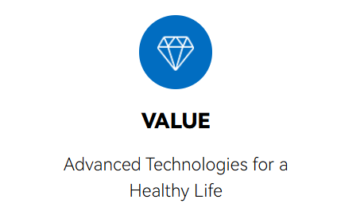
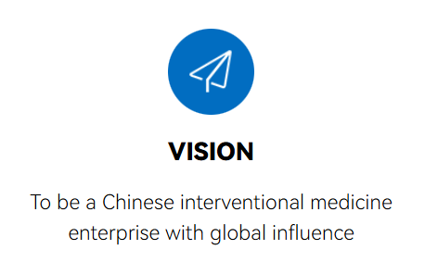
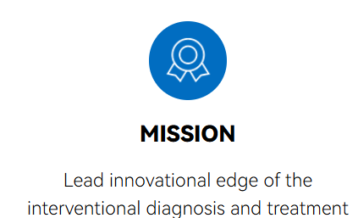
Introduction
Chineses company
Established in 2018
Focus on cutting-edge medical technology and innovation for non-vascular interventional medicine
Direct and aggresive competitor (price sensitive)
Not focus prostate, clinical applications for Urology (supports diagnosis and treatment for kidney, prostate, bladder, stone clearing,), Hepatology, musculoskeletall
Clinical performance: use in 600 hospitals and assist to complete 8500+ surgeries
Majors partners: Drexel University, Johns Hopkins University, And Nanjing university of Science and technology
Lower price:
End user price about One hundred thousand euros (100K€) => Price different for each territory
Cost per case (mandatory consumable) about two hundred and twenty euros (220 €)
Notes:
Presence: Focalisé sur les marchés émergents
•Se concentrer sur les technologies médicales de pointe et l'innovation dans le domaine de la médecine interventionnelle non vasculaire
rein, prostate, vessie, élimination des calculs
Hépatologie, musculosquelettique
N’hésitez pas à nous communiquer les offres de prix des différents territoires
On les a vu à l’EAU, à l’AUA, Monica est-ce qu’ils seront à la CAU? N’hésitez pas à communiquer les infos tous les congrès

Slide 4

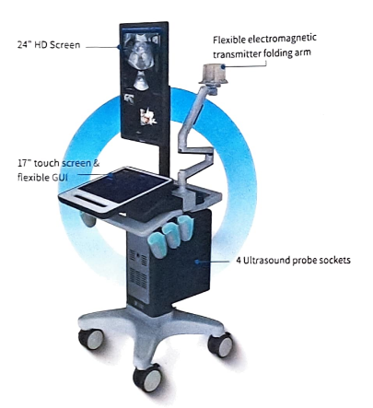
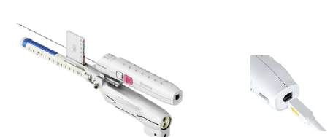
Product overview
Venus: 3D navigation & image fusion system
Not focus prostate, organ specific programm for prostate & kidney (tumor biopsy/ ablation/ recession)
Non-ionising PCNL for the treatment of percutaneous nephrolithotomy (kidney stones)
Transperineal fusion biopsy only (no TR)
4 ultrasound probe sockets
Rigid fusion
Electromagnetic tracking (probe & needle tip tracking)
Prostate 3D reconstruction
IA for automatic segmentation of prostate in MRI and US
Automatic Target segmentation
Automatic planning for biopsy = suggested needle path
Support tumor ablation – what FT procedure ?
Working on microwave focal therapy
/!\ Vehicle conveying inaccurate information about us in marketing materials
=> Ex: Koelis performs only cognitive fusion
=> Positioning in the diagnisis & treatment segment
Notes:
Capacité de needle tracking
c'est de la néphrolithotomie percutanée, c'est pour enlever les calculs rénaux
Avez-vous des demandes de biopsies de rein? Est-ce que ca vous paraîtrait nécessaire ? (sonde convexe)

Slide 5
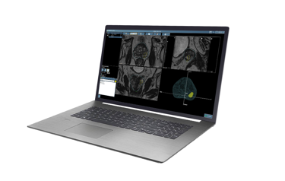
MR images preparation
ProMap Lite
Dedicated easy to use software for both radiologists/urologists
MRI, PET & CT compatibility

Slide 6
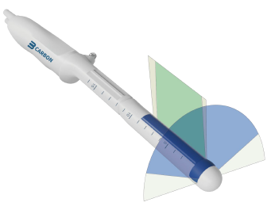
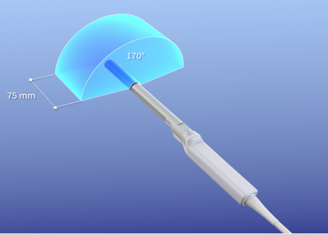
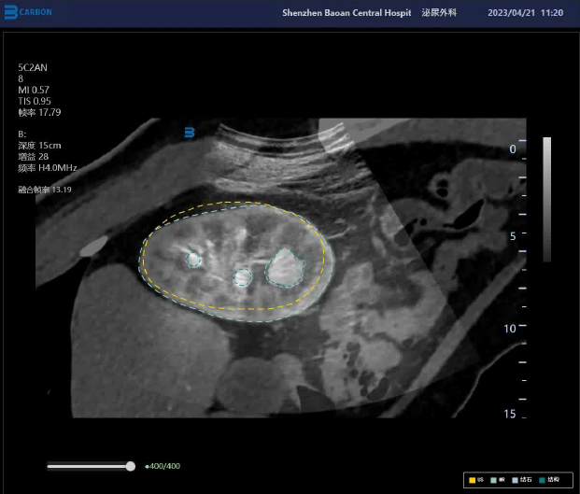
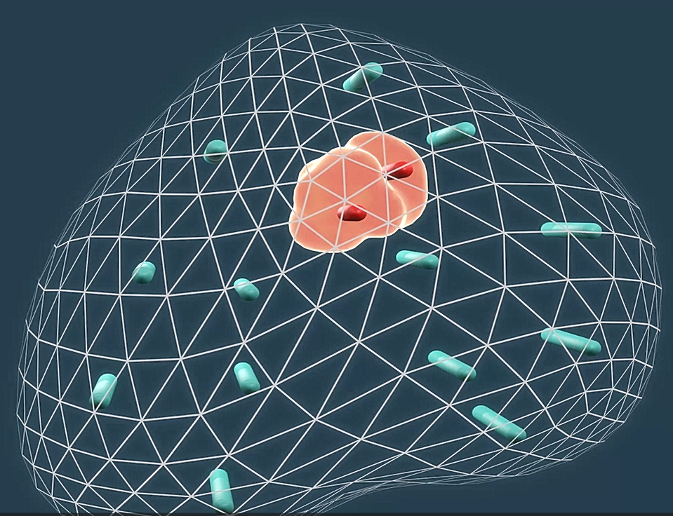
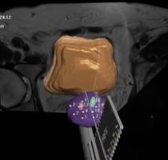
Fusion
Rigid fusion, 2D probes & probe tracking
Elastic fusion, 3D probes & Organ-Based Tracking
Rigid MRI-CT/US Fusion
2D US probes
Probe & needle tip tracking:
Questionnable accuracy ?
No compensation for organ déformations or patient movements
2 EM trackers required, one for probe, one for needle. Both are disposable. About 200 euros end user price per case
3D prostate mapping
Elastic MRI-CT-PET/ Us Fusion
3D US probes
Koelis Organ-Based-Tracking
Prostate tracking with proven accuracy 2,5 mm (Cornud et al. Study 2018 Urology Journal)
3D prostate mapping

Slide 7
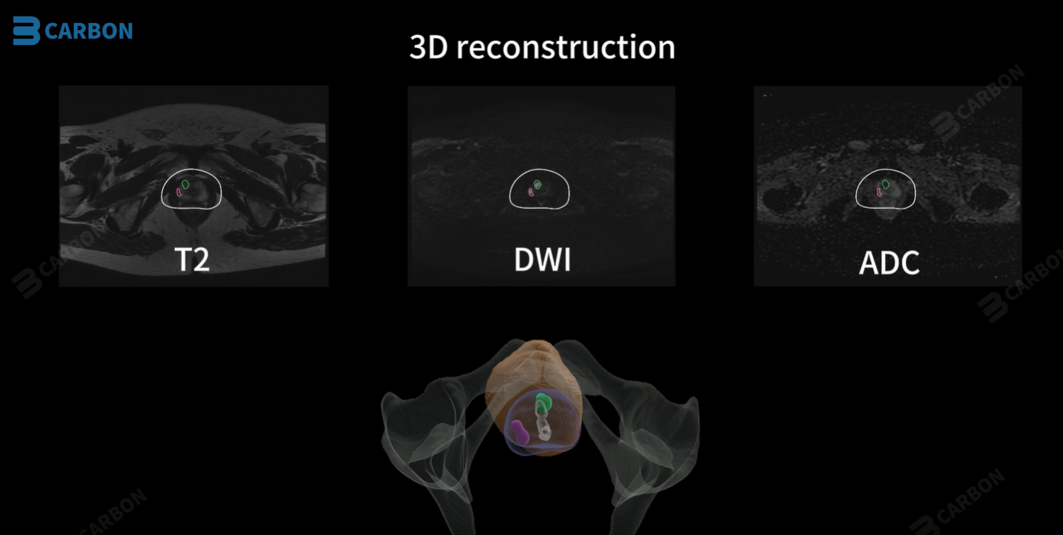
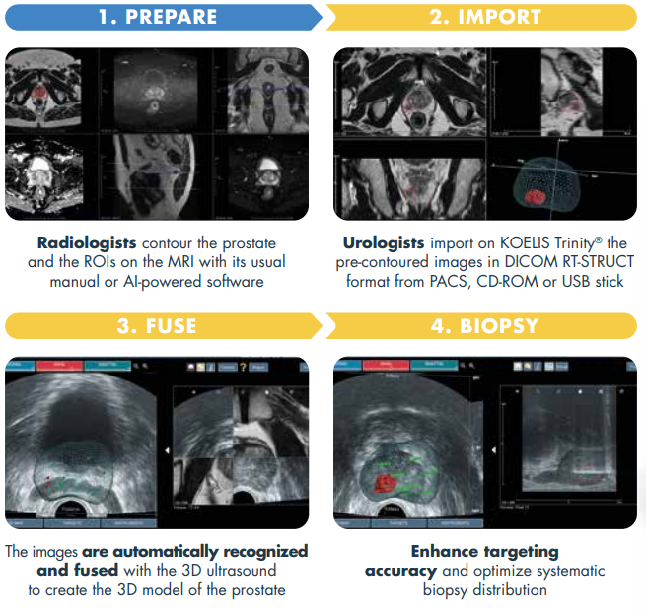

Intelligence Artificial
Automatic prostate segmentation on MRI and US images
Automatic target identification which is “a bit crude” (Doctor testimonial)
ProMap Contour: Software option on KOELIS Trinity® that facilitates collaboration between radiologists and urologists for an optimized prostate biopsy workflow.
AI annotations from third-party radiology software can be imported directly into KOELIS Trinity® via the standard DICOM RT-STRUCT.

Slide 8
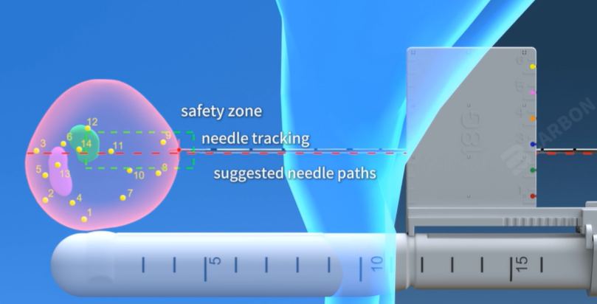
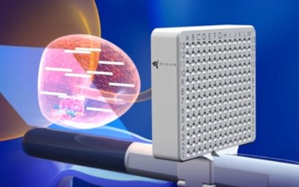
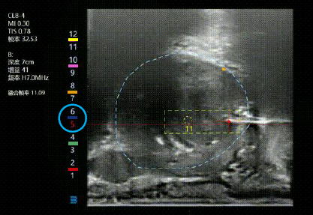
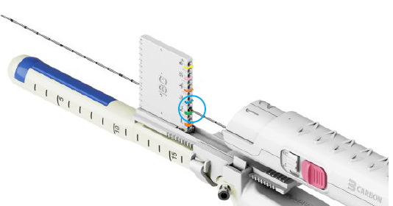
Pathway planning
Pathway planning
No Full Grid, only linear grid
Automatic setting for 12 systematic targets
Live Target visualisation
Color sequence for biopsy holes
Motionless Transperineal Grid Targeting
Biopsy planification for efficient repartition of the cores
No probe movements during the whole procedure
Notes:
Capacité de needle tracking : Suivi de la pointe de l'aiguille

Slide 9
Treatment
ProMap FT Software
Support tumor ablation – what FT procedure ?
They don’t have Full Grid
KOELIS Trinity® for needle-based focal therapy:
Koelis Targeted Microwave Ablation
IRE
Cryotherapy
HIFU

Slide 10
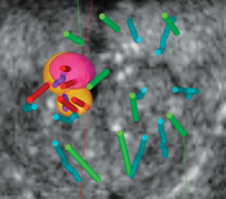


Follow-up
2nd Look fusion for data recall
For futures procedures: 3D map of first exam can be recalled to guide additional procedures such as Active surveillance and/or Focal treatments using 2nd Look technology
Advantages:
Active surveillance: Re-biopsy at the same location or explore surrounding areas
Focal treatment: Treat at the exact location of the positive cores

Slide 11
Comparison
 | Carbon | Koelis
Organ specific programm | Prostate, kidney | Prostate
Internationa presence | No | Yes – more of 700 systems wordwide
Fusion registration | Rigid fusion | Elastic fusion
3D US probe | No | Yes
Needle tracking | Magnetic navigation | Koelis Organ-Based-Tracking
Transperineal fusion biopsy | Yes | Yes
Transrectal fusion biopsy | No | Yes
Automatic planning | Yes | Yes (3D probes + Full Grid)
IA for automatic contonting in MRI and US | Yes | No but we have ProMap Contour
IA for target detection | Yes « a bit crude » | No
2nd Look Fusion | No | Yes
Support FT procedures | Yes | Yes proMap FT
Microwave treatment | No | Yes
Complete solution for Pca: diagnosis, treatment, follow-up | No | Yes
Notes:
Freehand ou stepper
Fréquence des sondes

Slide 12
Thank you

